Slide 1
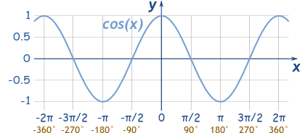

Cosine Wave Form

